Slide 1

Notes:
Welcome to the Aion Path. This is a rite of passage journey you will take with your sons or daughters, starting when they are 12, 13, or 14.

Slide 2

Notes:
Aion, pronounced Eye-On like keep your Eye on the path, is a Greek word that means “A moment in time that impacts all of time”.

Slide 3

Notes:
We are facing a crisis in the big C Church. Kids are leaving church in unprecedented numbers, more than a million a year, never to return.
This is not how it has been most of American history. It’s not how most parents Invision their future with their kids and grandkids.
For most of American history, if you were raised in a Christian home, there was a 90% chance that you would identify as Christian when you were 30 years old.

Slide 4
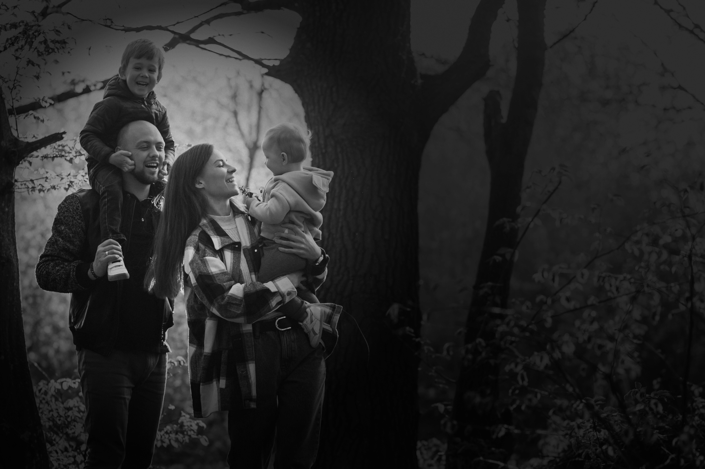
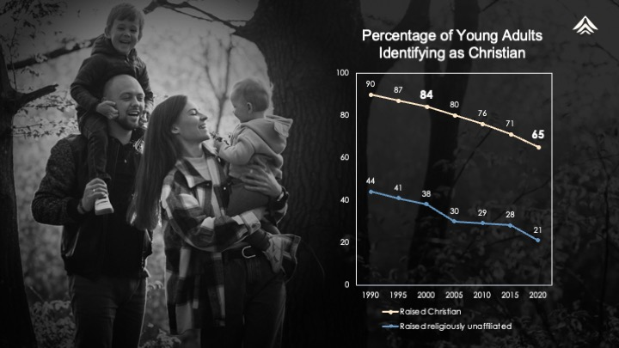
Notes:
In 2000, if you were raised in a Christian home which is the top line on the chart, there was an 84% chance you would identify as a Christian in your 30’s. The trajectory has steadily moved down, hitting 65% in 2020 and expected to be another 5% lower this year, in 2025. Many parents whose kids are young adults today are experiencing this angst. Their kids, and now their grandkids, don’t attend church, don’t prioritize faith, and in some cases don’t even prioritize their relationship with them.
[Presenter, share any anecdotes you have about the decline of faith amongst young adults, such as “My daughter says she can think of a total of two kids from her youth group days that prioritize church today, and that’s from an active, exciting well-led youth group that had about 75 kids in each grade.”]

Slide 5
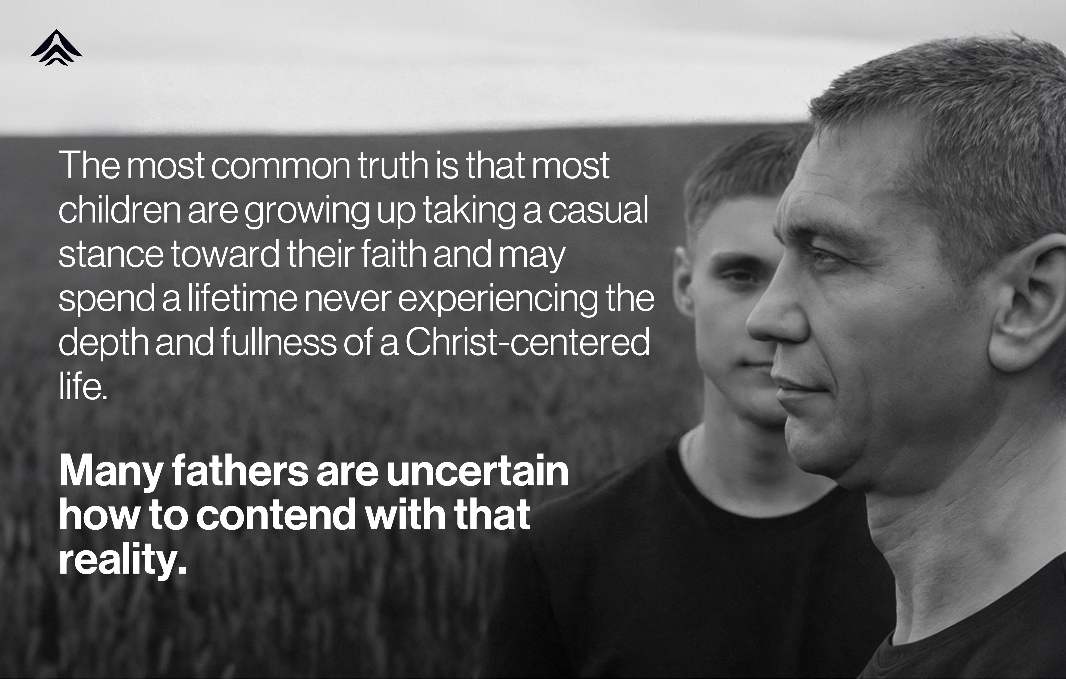
Notes:
[Presenter, read the text on the slide out loud, then say...]
Many of us, particularly us dads, know that the spiritual formation of our family is our responsibility, but we don’t know how or what to do about it. Maybe you didn’t have a good example growing up. Or maybe you had a good dad and yet still feel uncomfortable with the responsibility.

Slide 6
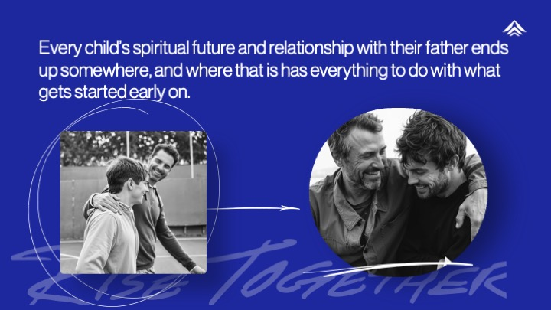
Notes:
[Presenter, read slide out loud, then say…]
Maybe you’ve been happy to outsource spiritual formation to the youth group, because you’re afraid if you get into a theological discussion yourself it might actually backfire and cause your kid to doubt the validity of our faith.
Or, you may be that dad who has been working at this the best you know how. But now, you’re questioning whether it’s a good idea to spend your limited time and money on club sports, cheer, dance, or countless other activities that come at the cost of family dinners and quality time together.

Slide 7

Notes:
Most dads don’t feel equipped or have a clear direction. That’s where The Aion Path comes in—it’s a proven journey designed to equip you, dad, to walk alongside your ‘Apprentice’ and launch them confidently into adulthood.
The Aion Path is a rigorous journey, like the progress toward the Eagle Scouting award.
It takes three years to complete, starting at age 12, 13, or 14.
It’s led by fathers, one-on-one with their Apprentices (the Aion Path calls your teens “Apprentices” because they are apprenticing to become adults)
It’s a path to deepening their engagement with church.
At the end, they will be presented to the congregation as adults able to lead themselves well, lead others well, and follow Jesus well.

Slide 8
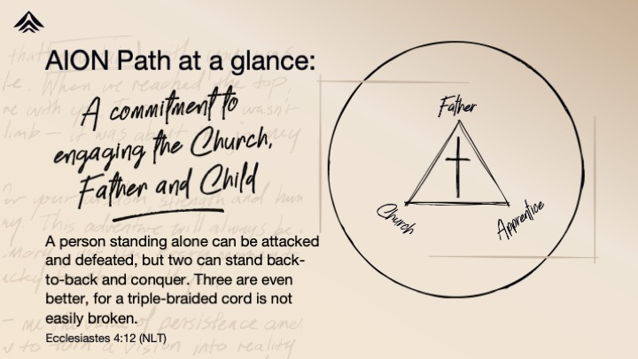
Notes:
The Aion Path is relationship-driven, as pictured by the cornerstones of Father/Church/Apprentice. There is no greater influence on a child’s values and the transfer of our faith than dad. It is also critical that you are connected to the local church.
Success on the Aion Path is when you have a great relationship with your launched adult children, and they have a great relationship with Jesus.
It is designed so you, as a dad, don’t have to know more than your Apprentice at any point.
You don’t have to be a spiritual giant, but the Aion Path does set you up to be the hero.
Your job is to prioritize completing the Aion Path.
You will be equipped so you can travel alongside your Apprentice with a spirit of curiosity and learning.
Okay, so you say yes, I’m in, sign me up. What is it I’m signing up for?

Slide 9
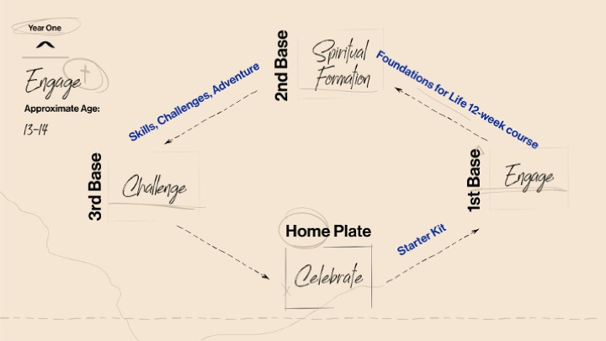
Notes:
This is what will happen in Year One. Think about it as having 3 bases and a home plate celebration.
To get to first base, you’ll go through the Starter Kit. That will take 2-3 months to complete.
Then, you and the other dads and Apprentices from our church will go through the 12-week Foundations for Life course together.
The rest of the year you’ll do your skills, challenges, and adventure.
That run in from 3rd to Home should feel like you just hit a walk off homerun and your teammates and family are gathered at the plate to congratulate you while the fans are going wild!!
Let’s look in more detail at each of the bases.

Slide 10
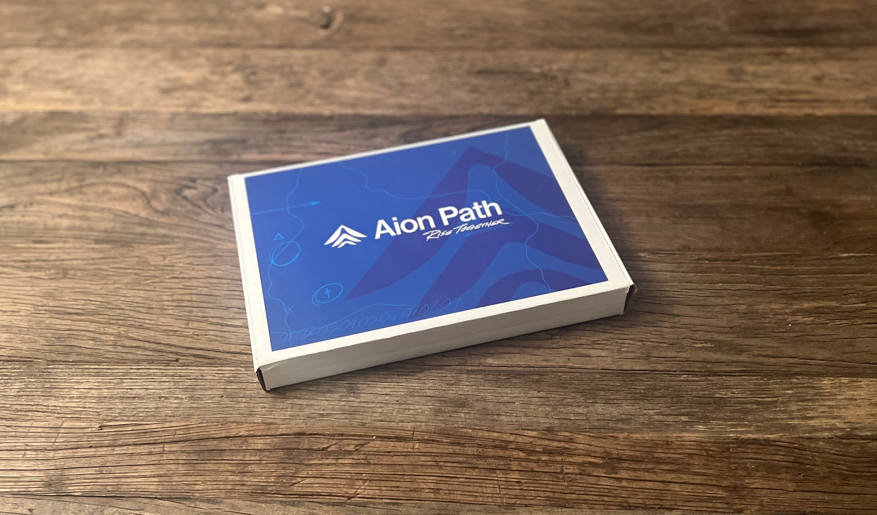
Notes:
If you sign up today, this Starter Kit will show up at your home in 5 to 7 days. While you’re waiting for it to arrive, you can join the Aion Path online community,

Slide 11
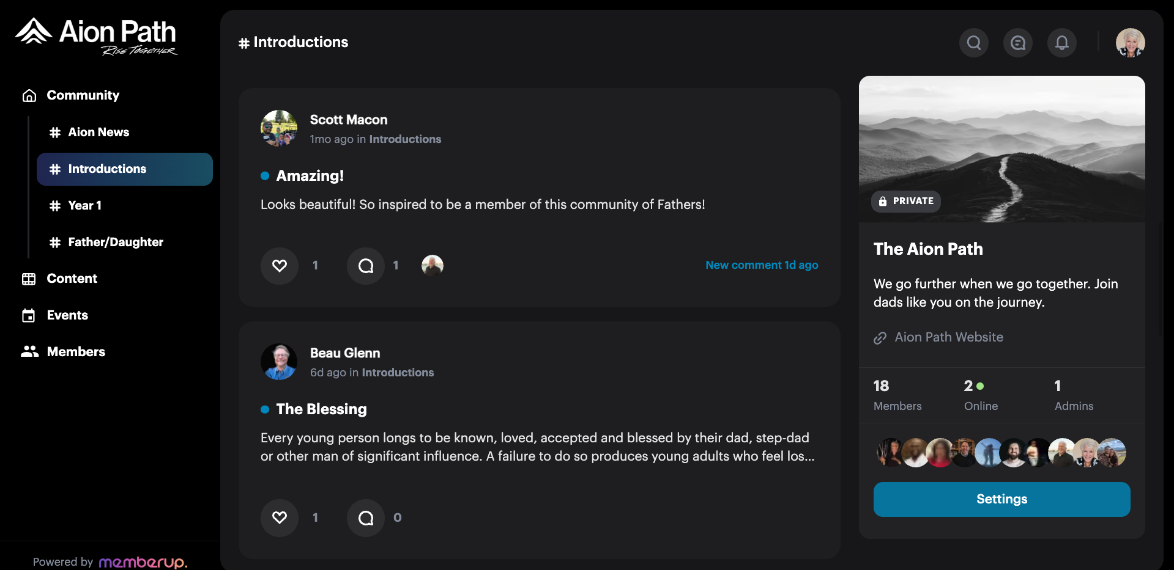

Notes:
Start off in the community by introducing yourself, and begin connecting with the greater community of dads to encourage each other and learn from each other. This online community is where you will post about your progress, and alert the Aion Path team when you’ve accomplished milestones so they can send you your challenge coins or other rewards and challenges.

Slide 12


Notes:
Once your kit arrives, open it up and find the 5 envelopes that will take you through the first 5 steps of your journey. This will “take you to first base”, which we call “Engage” because these are the planning steps that get your Apprentice fully engaged with the journey. The first four envelopes should each take you about a week to do, and the fifth one is a 30-day challenge, so think of this run up to first base as a 2-3 month process.
These 5 envelopes are designed to be done by you and your Apprentice alone, and not together with other dads and kids. So, we encourage you to sign up and get your starter kit, and get going with the first couple of envelopes. In 4 weeks, [give date for Rally], we will get all you dads back together for a Rally meeting so we can check in with each other on how it’s going, compare notes, and help each other to be successful with the upcoming envelopes.

Slide 13
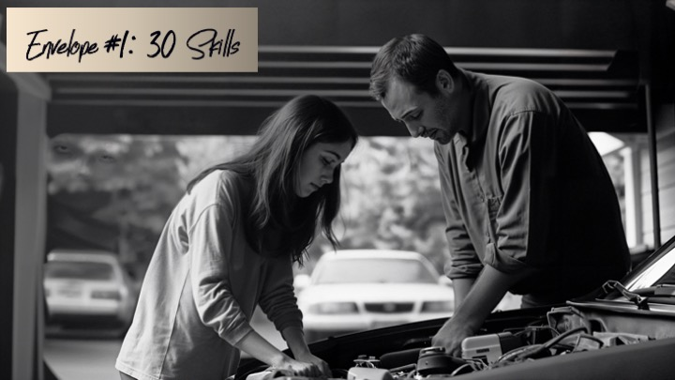
Notes:
Envelope #1: 30 Skills
You and your Apprentice are going to sit down and think of 30 life skills they want to acquire over the next 3 years, such as, I want to learn how to change the oil, start a campfire, grill a steak, give a toast, start a conversation with an adult, or learn self-defense. If you need inspiration, we include a list of 160 ideas in categories such as:
Automotive
Street Smarts
Mental Health
Home Management
Outdoor
Professional
and 10 other categories. The job is to come up with the list of 30 skills they want to learn, 10 a year for the next 3 years.

Slide 14
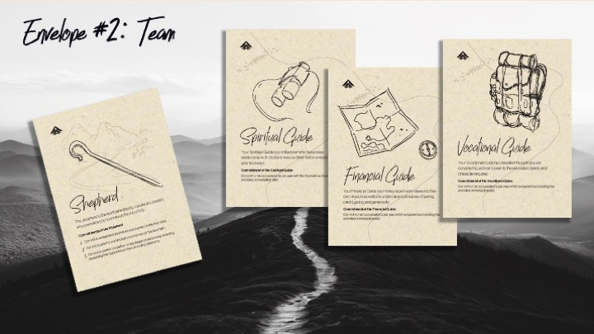
Notes:
In Envelope #2 you are choosing your Team, which is made up of a shepherd and 3 guides. This intergenerational connection is one of the most impactful parts of the Aion Path. Researchers tell us that strong relationships with three or more non-parent adults in the church is one of the key predictors in determining whether young people stay involved in the church after high school.
Your Shepherd is our Senior Pastor or a pastor you know in the church. The Shepherd signs off on the completion of 2-3 key milestones during the year, and he presents your Apprentice to the congregation at the rite of passage ceremony.
Your three Guides are 3 believing, mature adults who are willing to meet with your Apprentice for two conversations per year. You’ll choose a Spiritual Guide, a Financial Guide, and a Vocational Guide, and they will each be provided with a conversational plan to follow. The conversations will go beyond matters of finance and career, getting to their faith journey and how they apply their faith in their work, in their handling of money, and in their identity.

Slide 15

Notes:
Envelope #3 is about church engagement and encourages your Apprentice to be not just engaged in their youth programs, but to also join you for worship on Sundays sometimes. There is a self-assessment for the Apprentice to take to determine how much they value church involvement.
Then both the dad and the Apprentice will set some goals for meaningful church participation. The goal setting worksheet gets you to consider things like
thinking about the meanings of the words to the songs as you’re singing
noticing new people and helping them feel included
understanding your spiritual gifts and using them to serve.
The idea is for both of you to commit to improving in how you meaningfully participate in church in one or two areas.

Slide 16

Notes:
Number 4 is planning your Adventure, which is an overnight experience the two of you do together. You will be given some some great prompts to begin imagining an adventure that pushes you outside your comfort zone and gives you quality and quantity time together, free from distractions, and creating lifelong memories. You will be going on an Adventure together once a year for each of the 3 years.

Slide 17

Notes:
The 5th and final envelope may be the most important of the year. It’s called 30 Conversations, and you and your Apprentice will commit to meeting every day for 30 days and spending at least 10 minutes in conversation with each other. In order to accomplish this we give you an App…

Slide 18



#5: 30
Envelope Conversations
Notes:
…we give you an app called 30 Days that has been used by thousands of parents over the past 10 years. In fact, one very high-profile dad told us that this tool didn’t just save his relationship with his son, but saved his son’s life.
Every day the app gives you a prompt, such as, Dad, say this: “Hey, change can be hard. What was a change you experienced this year and what was hard about it?” Then the app prompts the Apprentice to say, “Hey dad, what was a change that was hard for you when you were a kid?”
This app will guide you to get to know your kid, and they will know without a doubt they matter to you. Think of what you’re communicating when you make sure you connect, even if that means you are away on business in London and you have to wake up for your call at 3 AM, or you step out of the Dodger game in the 6th inning to connect by phone before bedtime. Nothing says “you matter” like showing up when it’s not convenient.
At the end of the 30 Days, you’ve made it to First Base! A Challenge coin is on its way to you to present to your Apprentice to commemorate this milestone on your journey.

Slide 19

Notes:
Once you complete the five envelopes, you’ll move into the runup to second base, which is called Formation.
This is a 12-week interactive Spiritual Formation Course that we will go through together as a group.
The first year’s course is called Foundations for Life, and it addresses some of the big questions like, Is God real? How can I relate to him, and how does he relate to me? Or, why does God allow pain and suffering?
This course is not designed so the dad must teach. It is designed so a dad and his Apprentice can journey together, learning alongside of each other, exploring the big questions together.
After you finish the Foundations for Life course, you’re on the runup to 3rd Base.

Slide 20
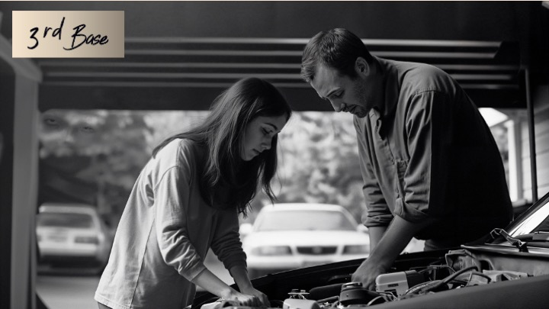
Notes:
The remainder of the year is devoted to the Challenges and the Adventure.
Remember those 30 life skills you identified in Envelope #1? If you haven’t already started on those, now is when you’ll knock off the first 10. The fun of this is that you are doing it together. If “change the oil” was one of the skills your Apprentice chose but that’s not your thing, find a buddy whose it is and have them teach both of you.

Slide 21

Notes:
Another thing you get to do in the last half of the year is go on that Adventure you planned back on Envelope #4. Be sure to post pictures of your Adventure to the Aion Path Online Community to update the larger community on what you’re doing.
Also, your Apprentice will schedule those conversations with their 3 guides.

Slide 22

Notes:
In addition to the 10 skills and 1 Adventure, and 6 Conversations, your Apprentice will be given some spiritual challenges to accomplish during this last half of the year. This will be things like:
Spending 30 minutes in silence and reflection. That’s 30 minutes alone, no phone, no watch, no music, nothing but a pencil and paper, a Bible, and their thoughts.
Keeping the Sabbath: learn what Scripture teaches about it and challenge your Apprentice (and yourself) to “keep the Sabbath” at least 4 times.
Reading a book of the New Testament out loud to each other.

Slide 23


Notes:
Getting to home base at the end of the year is no small accomplishment. You have completed 30 days of relationship exercises,12 weeks of spiritual formation, learned life skills and taken on spiritual challenges—to say nothing of the learning and investment in each other you have made along the way. This calls for a celebration with our group!
There will be a presentation of a formal gift to mark the moment. One item that will be made available only to those who have completed the first year is a Bible with a custom leather cover, handcrafted by 4th generation leather crafters out of Arkansas. It has a hidden pocket for dad to put in a letter of affirmation, making this Bible a lifelong treasure that will always be connected to the experience of the time they had with their dad.

Slide 24
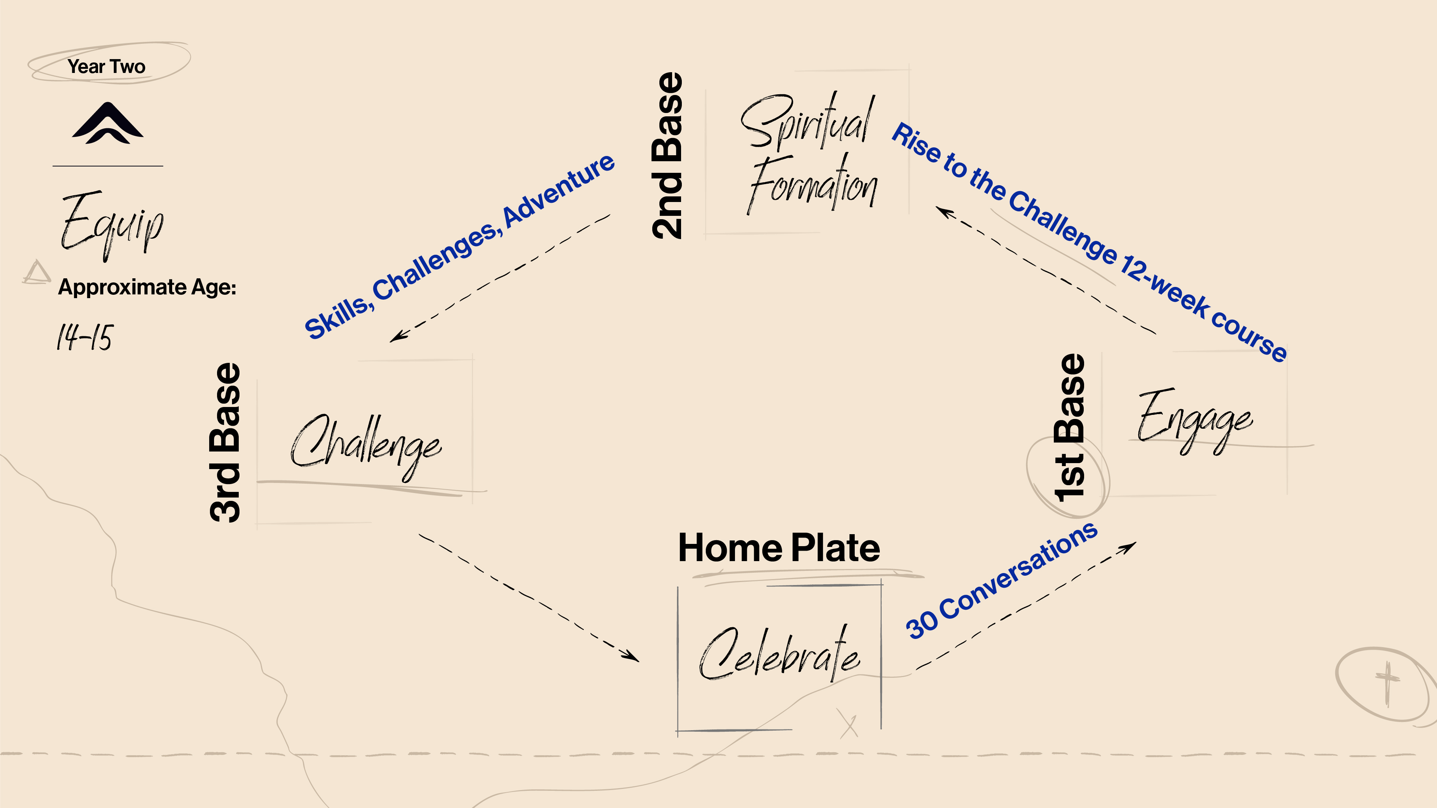
YearThree@2x-100.jpg
Notes:
Completion of the first year is required to be invited to the second year, which is called Equip. You will notice the subtle shifts between Year 1 and Year 2. In Year 1 your Apprentice was following, and now in Year 2 they move to walking alongside. Year 2 starts with another set of 30 conversations to get you to first base, the Engage stage.
There will be another 12-week spiritual formation course that will move into equipping our kids to deal with the real and practical issues that they are asking about.
The challenges they will encounter when moving to 3rd base will be deeper in Year 2. For instance, this year they will be challenged to spend not 30 minutes, but 3 hours in solitude and silence.
You will finish Year 2 with another celebration and commemoration of their accomplishments, and then on to Year 3.

Slide 25
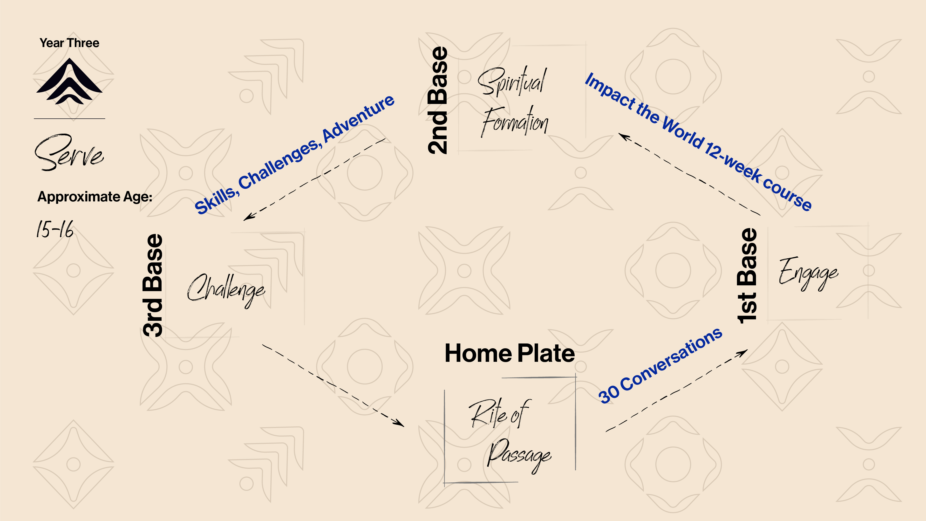
YearThree@2x-100.jpg
Notes:
In Year 3, the shift is to a focus on serving others, and the Apprentices will be challenged to step up and take on leadership responsibilities. The 12-week spiritual formation course is about how they can impact the world by living and serving like Jesus. Their challenges involve a 6-hour solitude and silence exercise, writing two Biblical essays, and a service project.
The celebration for the final year is the biggest one yet…

Slide 26

3 years of engagement for a lifetime of fulfillment.
Notes:
It’s the Rite of Passage ceremony, where the pastor will present the Apprentices to the congregation as adults, ready to lead others well, lead themselves well, and follow Jesus well.

Slide 27


Register today.
Your Starter Kit will arrive in 5-7 days.
Rally for all dads
[date/time/place]
Scan QR code to register
Or go to www.aionpath.com
Notes:
The first step you can take is to go online to AionPath.com or scan this QR code and register. Your registration starts the ball rolling and gets you access to the community. Once you get your kit, go ahead and open it and get started on your envelopes. By the time we have our rally next month, we should all be partway through the Starter Kit and ready to compare notes, share our experiences so far, and help each other get ready for what’s ahead.
A rising tide raises all ships. Let’s get registered today and be that tide for this generation.

Slide 28
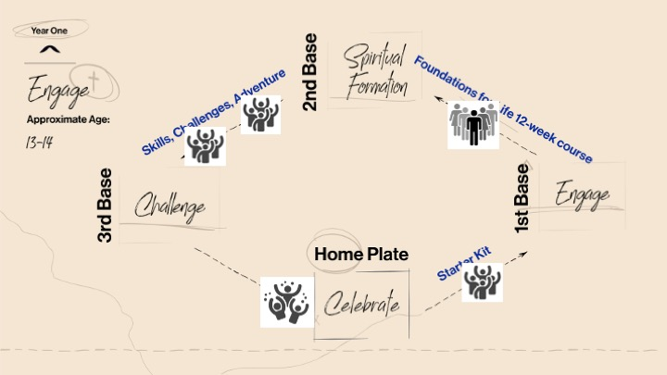
Notes:
THIS SLIDE IS FOR THE Q & A PORTION OF THE MEETING
Our first quarterly rally happens midway through the Starter Kit phase, which will take place a month from now on [date].
After we complete the Starter Kit activities, we’ll all get together for the 12-week Foundations for Life course here at the church. We will be hosting two groups—a fathers and sons group, and a fathers and daughters group, and these groups will start meeting [give date/place]. The curriculum is set up to do a segment of teaching to the whole group, then you turn to your son or daughter and discuss the questions just between the two of you.
The next two quarterly dads’ rallies will happen during the last 6 months of the year while you and your Apprentice are working your way through the Life Skills and Challenges on your own.
When we get to the end of Year 1, we will have a big celebration to commemorate that milestone.

